Slide 1
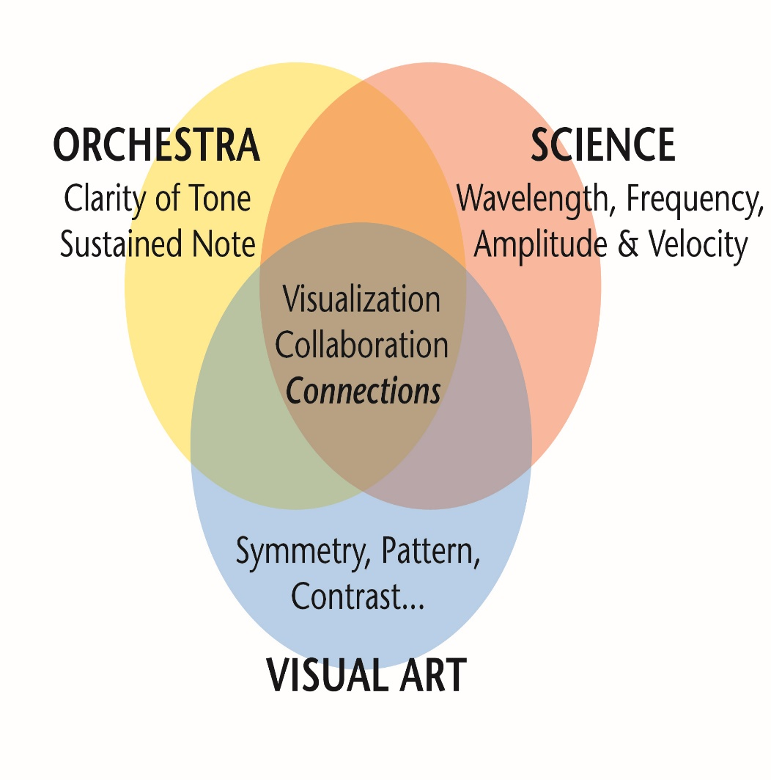
This Scientific Poster Template Is Provided By MakeSigns
Enter A Title And Add Logos To Your Poster
Add Author Names and Information
Include University or Department Names if Needed
Abstract
Engineering Design Process
Results/Conclusion
Add your information, graphs and images to this section.
An abstract is essentially a short synopsis of your project, or a trailer for a movie. The term “abstract” is used specifically for research papers where users must pay to have access to the paper, but the abstract can be read freely so the reader can determine whether the paper is worth the time or money to read. In this regard, an abstract has a subtle yet distinct difference from an introduction.
As it relates to our projects, why I am having us write and include abstracts on our STEAM posters is because:
It’s a good term to know and be familiar with
While we are all familiar with our projects, guests at the STEAM symposium will not be. Our projects have a penchant for the unusual, so that guest seeing the word “abstract” and reading a paragraph is helpful for their understanding
Abstracts will need to be written by April 28th for all projects to be submitted in the STEAM magazine. Writing it now kills two birds with one stone
Add your information, graphs and images to this section.
You don’t need to include the engineering design process on your portfolio, but I highly recommend it as it is an easy way to show the progression or “story” of your project and because we have all put in some degree of effort to document the EDP for our projects on our portfolios. And remember, this is a poster and not a paper; we want our posters to be eye-catching so lean more towards pictures/graphs/tables and limit blocks of text to being no more than a paragraph at a time.
While you are more than welcome to design your poster however you wish, how I would do it would be to include one of the Engineering Design Process graphics I included below (or choose a different EDP, there are dozens of variations you can find on the Google-machine), write a short explanation for each step, then paste in pictures/Gantt-Charts/research/more-pictures/tables/graphics/even-more-pictures in accompaniment with each step. The reason I might use the 5-step EDP here as opposed to the 8-step one which our portfolio rubrics are modeled after is because of space. Trying to jam eight headings into here might get a bit cluttered, but do whatever you think is best for your project.
Add your information, graphs and images to this section.
You may think this section is somewhat redundant to part of the Engineering Design Process section, and you wouldn’t be entirely wrong. In fact, if you want to just delete this section and just cover the final product in the EDP section that is 100% fine. From a on-lookers perspective, however, it is nice to see a heading that says “Results” and then to see pictures of the final result and a few words/a paragraph on the result. To distinguish between the EDP section and the results section, think of the EDP as being more about the process and this section about the product.
Ask
Add your information, graphs and images to this section.
Why are you doing your project? What made you choose this specific project? I’d keep this section short, no more than the briefest of paragraphs, and you could even do it by just writing one question.
Imagine
Add your information, graphs and images to this section.
Not too much to say here. Briefly discuss how you approach the “ask” (this is pretty similar to the objective on your portfolio). Bonus points if you mention constraints and criteria
STEAM
Plan
Add your information, graphs and images to this section.
A Gantt chart here would be GREAT. Just clean it up so it’s not 20 pages and is legible
Future Steps & What we Learned for Next Time
Add your information, graphs and images to this section.
STEAM is kind-of the whole point of this symposium, so lets give it a shout out on our posters. To accomplish this I would:
Include a bullet listing in this section of “Primary Subject: _____” and a rational as well as Cross Curricular Subject: _____” and a rational. You can have multiple primary subjects and multiple cross curricular subjects, the more the merrier
Make a venn diagram similar to the one below. Admin loves this picture. . If the venn diagram makes the list from #1 seem redundant than just do the venn diagram
Add your information, graphs and images to this section.
Especially because many of our projects still have work to do and because we many of us may have learned something along the way, this section is important to include. I think a paragraph here is a sufficient way to address these topics and to figuratively put a bow on our poster.
Create
Add your information, graphs and images to this section.
This is the meat and potatoes of the EDP. Use the space here as well as the space to the right of this graphic/text for pictures of the process, you working, and the “story.” You can accompany this with a sentence or two (or a brief paragraph) in this text box
Test & Evaluate
Improve
Add your information, graphs and images to this section.
This section is similar to the “Create” section as it largely addressed by including pictures of the process of your work/you working.
For a list of subjects you can include, either go back and look at the STEAM proposal link you submitted or read the “STEAM Symposium Project Checklist” PDF (a link for both are on my blog)
Share your Solution
Add your information, graphs and images to this section.
An often overlooked but very important part of Engineering! With that said… Honestly, if you wanted to delete this step as it starts getting a little meta to be discussing making a poster and presenting I’d understand.
Here’s another two arrangement of the EDP (below) you could use. If you wish to use it, just ungroup the images and do what you gotta do.
2. Do Background Research
3. Specify Requirements
Ask
Imagine
1.Define the Problem
4. Brainstorm Solutions
Plan
Create
8. Test & Redesign
5. Choose a Solution
Test & Evaluate
Improve
7. Build a Prototype
6. Do Development Work
Share your Solution

